Slide 1
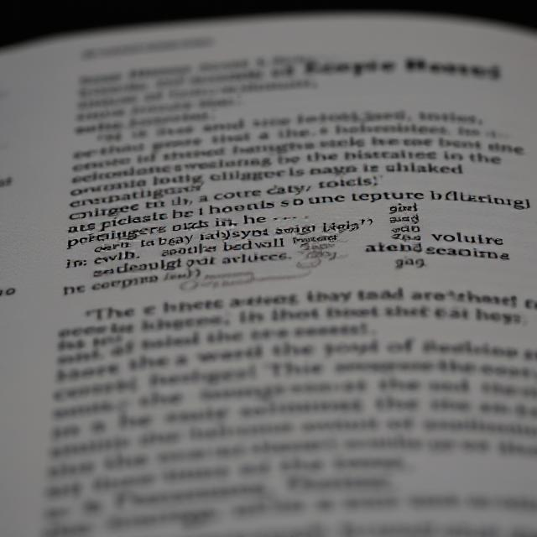

Question Answering Using Encoder-Decoder
Presented by:
Pranav Khatavkar 202201090028 Aditya Sawleshwarkar 202201090045 Omkar Karlekar 202201090088
Guided by:
Dr. Dipti Ghuse

Slide 2
Contents
01
Introduction
02
Paper Summary
03
Model Diagrams
04
Dataset Description
05
Graphs
06
Conclusion

Slide 3
Introduction
A text-to-text encoder-decoder model for question answering works by converting the question and its associated context into a single textual input, which is then processed by the encoder to produce a semantic representation of the information. The decoder then generates the answer one token at a time based on this representation, effectively "translating" the input into a relevant answer. This architecture allows the model to capture complex dependencies between the question and the context, and with the help of attention mechanisms, it can dynamically focus on the most informative parts of the input. Unlike traditional extractive methods, this approach supports both extractive and abstractive answering, making it flexible and powerful for a wide range of QA tasks, including those that require reasoning, summarization, or paraphrasing.

Slide 4
Paper Summary
This paper addresses the challenge of generating natural language questions from input text using encoder-decoder models. It aims to evaluate different encoder architectures and attention mechanisms to improve the quality and relevance of generated questions.
Aim and Objectives: To develop and evaluate encoder-decoder based models that automatically generate questions from textual input, leveraging recent advances in neural networks and large datasets.
Investigates and compares different encoder types: LSTM, GRU, and CNN-based encoders.
Uses attention mechanisms to improve the focus of the decoder on relevant parts of the input.
Benchmarks performance using BLEU and ROUGE scores along with training time.
Methodology
Data: Uses the SQuAD dataset, which contains question-answer pairs based on Wikipedia articles.
Encoders: Three types evaluated: LSTM, GRU, CNN Encoder
Decoder: A standard RNN decoder with attention, shared across experiments.
Training:
Used stochastic gradient descent (SGD).
Pre-trained GloVe embeddings used for improved performance.
Trained on GPUs with dropout and beam search decoding.
The paper concluded that GRU is a viable alternative to LSTM, especially when training time is a constraint.
CNN-based encoders, despite lower scores, are practical for faster training with competitive performance.

Slide 5
Methodology
The methodology involves a comprehensive implementation and evaluation plan:
Dataset: Utilize the SQuAD v1.1 dataset, which contains over 100,000 question-answer pairs based on Wikipedia articles, where answers are text spans from passages.
Data Preparation: This includes tokenization and converting answers to span indices (start/end positions), followed by creating train/validation splits.
Model Implementation: Develop the three mentioned model architectures in PyTorch.
Training Process: Train each model using a defined configuration with epochs .
Evaluation: Measure performance using key Question Answering metrics: BLEU, ROUGE, METEOR, Accuracy
Analysis and Visualization: Conduct detailed analysis by plotting training loss curves, visualizing attention weights (for relevant models), comparing performance metrics in tables and charts, and analyzing time performance and model complexity

Slide 6
Dataset Description
Space QA Dataset is a domain-specific question answering dataset centered on space science, astronomy, and space exploration. It includes over 1000 QA pairs structured in SQuAD-like format, with questions based on factual context passages about planets, rockets, missions, and celestial phenomena.
Key Features:
Source: Manually constructed context passages on topics like NASA, black holes, and SpaceX.
Answers: Mostly extractive, with text spans directly drawn from the context.
Format: JSON (topics contain paragraphs with questions and answer lists).
Availability: Provided as a .json file, suitable for supervised QA training.
Preprocessing: Tokenization and input-output formatting required for encoder-decoder models.
Why This Dataset?
Domain-specific resource for training QA systems in the space science field.
Supports both extractive and generative QA models (e.g., T5, BART).
Useful for educational, research, or science-focused AI applications.

Slide 7
Model Architecture
This foundational model utilizes a standard Encoder-Decoder framework to process the passage and question for question answering.
Architecture Type: Encoder-Decoder without Attention (LSTM/GRU)
Encoder: Bidirectional LSTM/GRU Processes passage embeddings (GloVe or similar) as input. Outputs hidden states for each token in the passage.
Decoder: LSTM/GRU Takes question embeddings as input, Predicts the start and end positions of the answer span within the passage.
Key Components:
Embedding layer: Converts input tokens into vector representations. Passage Encoder: A Bidirectional LSTM processing the passage. Question Encoder: An LSTM processing the question. Output layers: Linear layers to predict the start and end logits.

Slide 8
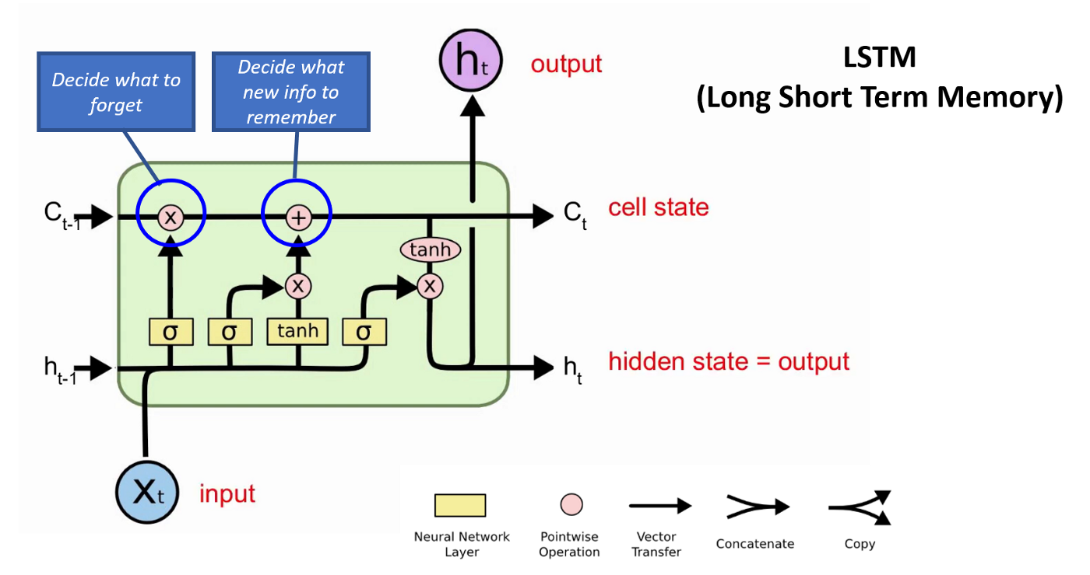
Architecture Diagram
Encoder-Decoder without Attention (LSTM)

Slide 9
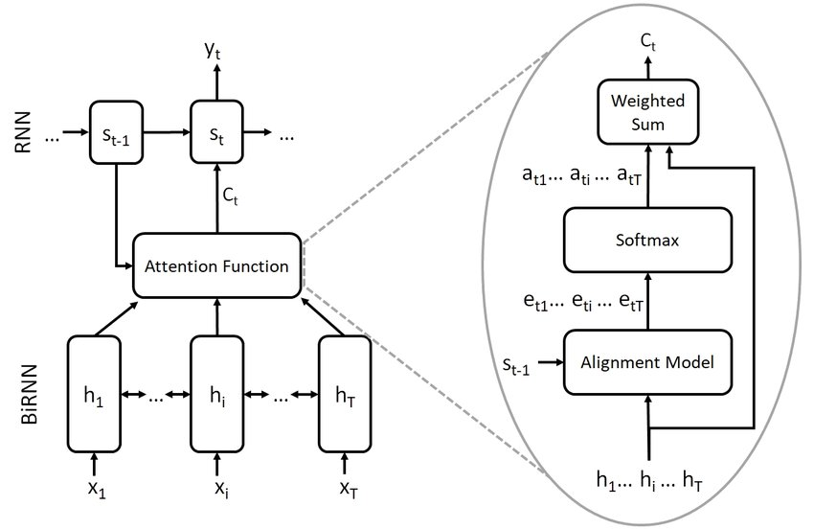
Architecture Diagram
Encoder-Decoder with Bahdanau Attention

Slide 10
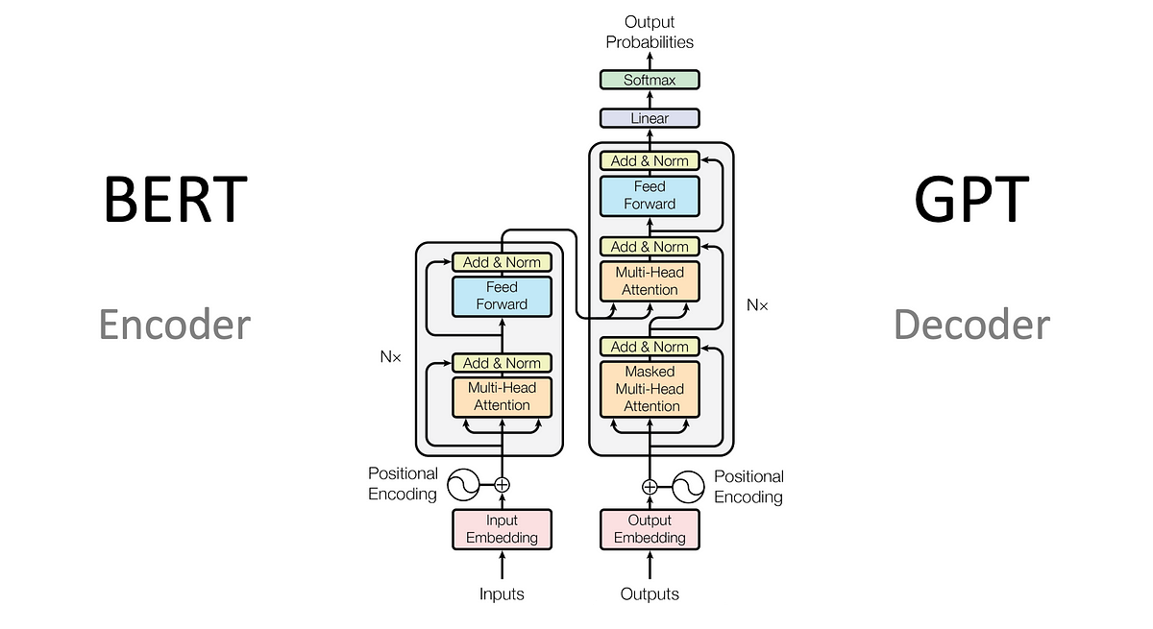
Architecture Diagram
Encoder-Decoder with Self Attention

Slide 11
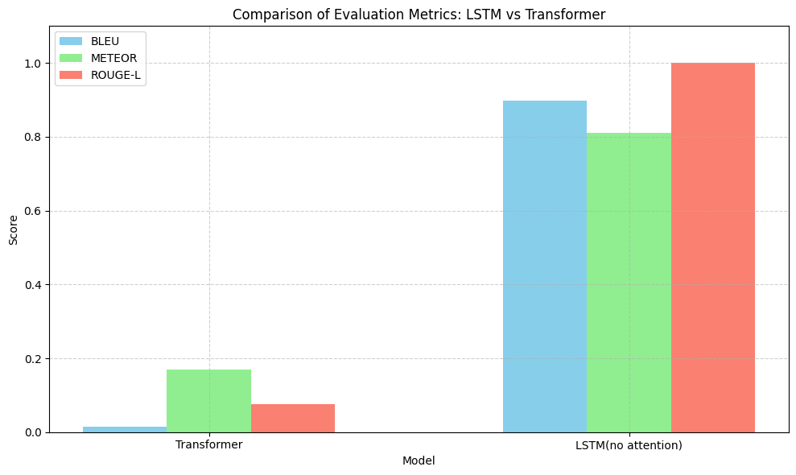
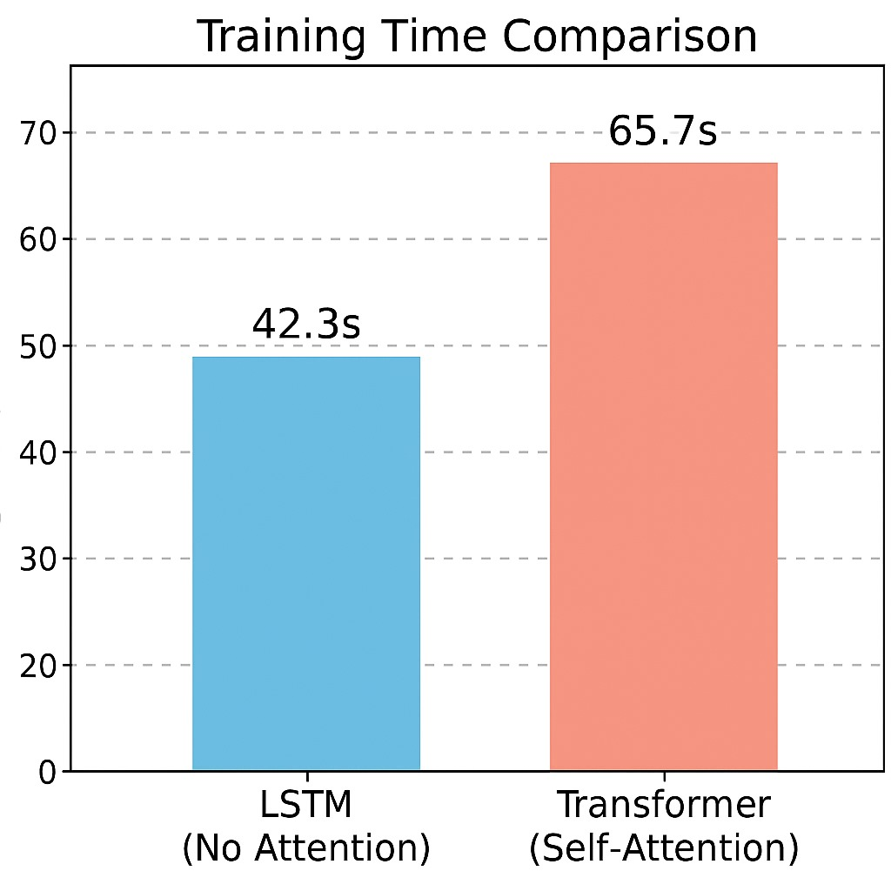
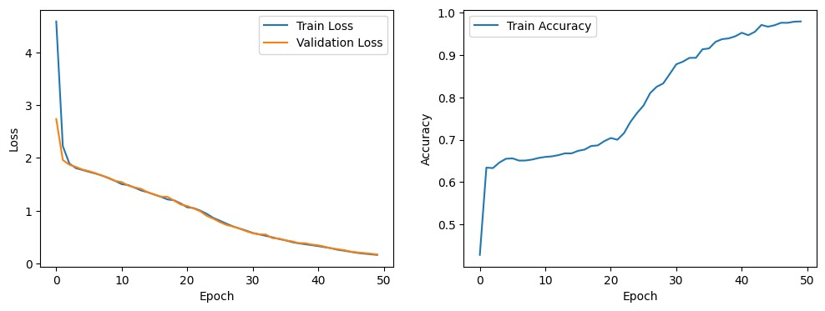
Metric-wise Graphs

Slide 12
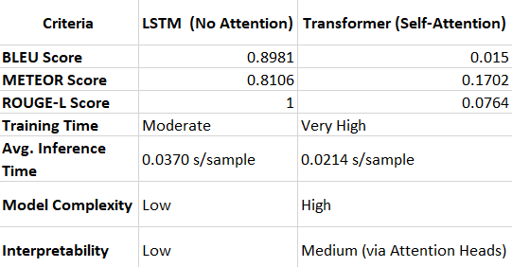
Final Analysis Table

Slide 13
Conclusion
This project explored and compared two fundamental architectures for Question Answering: an encoder-decoder LSTM model without attention and a Transformer model based on self-attention.
The LSTM-based model relies on sequential processing, where each token is processed in order, making it simple and effective for shorter inputs but limited in handling long-range dependencies due to the lack of direct connections between distant tokens.
In contrast, the Transformer model uses self-attention to capture relationships between all tokens simultaneously, enabling it to model complex dependencies and parallelize computations efficiently.
Through this implementation, the project highlighted the trade-offs between the two: LSTM offers lower complexity and is easier to train on small datasets, while Transformers, though more complex and computationally demanding, provide greater flexibility, scalability, and interpretability—making them a more modern and powerful approach for QA systems in real-world applications.

Slide 14
Conclusion
In this study comparing LSTM (without attention) and Transformer (self-attention) models for question answering, results showed that LSTMs significantly outperformed Transformers across all evaluation metrics—BLEU, METEOR, and ROUGE-L—despite the Transformer’s architectural advantages.
This performance gap is likely due to the LSTM’s simpler structure being more suitable for smaller datasets or limited training, whereas the Transformer’s complex architecture requires more data, tuning, and compute to realize its potential.
While Transformers offer benefits like parallelism, global context awareness, and faster inference, their high training time and sensitivity to implementation make LSTMs more effective in low-resource scenarios.
Ultimately, LSTMs provide stronger performance under constraints, whereas Transformers shine in well-resourced, large-scale environments.

Slide 15
THANK YOU

